Slide 1

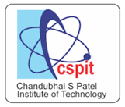
Ce443 : Cloud computing
Ch-6 advanced Cloud Architectures
Chandubhai S. Patel Institute of Technology

Slide 2
Advanced Cloud Architectures
Hypervisor Clustering Architecture
Load Balanced Virtual Server Instances Architecture
Non-Disruptive Service Relocation Architecture
Zero Downtime Architecture
Cloud Balancing Architecture
Resource Reservation Architecture
Dynamic Failure Detection and Recovery Architecture
Bare-Metal Provisioning Architecture
Rapid Provisioning Architecture
Storage Workload Management Architecture

Slide 3
Hypervisor Clustering Architecture
Hypervisors can be responsible for creating and hosting multiple virtual servers
Because of this dependency, any failure conditions that affect a hypervisor can cascade to its virtual servers

Slide 4
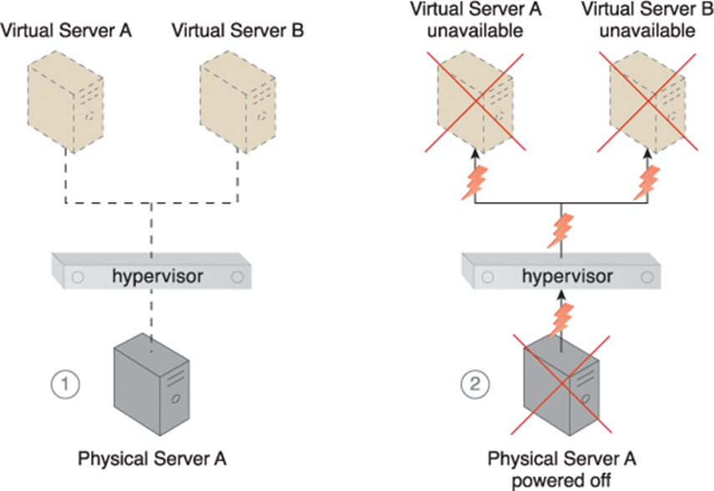
Hypervisor Clustering Architecture
Physical Server A is hosting a hypervisor that hosts Virtual Servers A and B (1).
When Physical Server A fails, the hypervisor and two virtual servers consequently fail as well (2).

Slide 5
Hypervisor Clustering Architecture
The hypervisor clustering architecture establishes a high-availability cluster of hypervisors across multiple physical servers
If a given hypervisor or its underlying physical server becomes unavailable, the hosted virtual servers can be moved to another physical server or hypervisor to maintain runtime operations

Slide 6
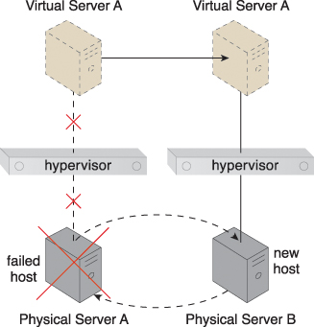
Hypervisor Clustering Architecture
Physical Server A becomes unavailable and causes its hypervisor to fail.
Virtual Server A is migrated to Physical Server B, which has another hypervisor that is part of the cluster to which Physical Server A belongs

Slide 7
Hypervisor Clustering Architecture
The hypervisor cluster is controlled via a central VIM(Virtual Infrastructure Manager), which sends regular heartbeat messages to the hypervisors to confirm that they are up and running.
Unacknowledged heartbeat messages cause the VIM to initiate the live VM migration program, in order to dynamically move the affected virtual servers to a new host

Slide 8
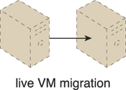
Hypervisor Clustering Architecture
Live VM migration
Live VM migration is a system that is capable of relocating virtual servers or virtual server instances at runtime
The hypervisor cluster uses a shared cloud storage device to live-migrate virtual servers

Slide 9
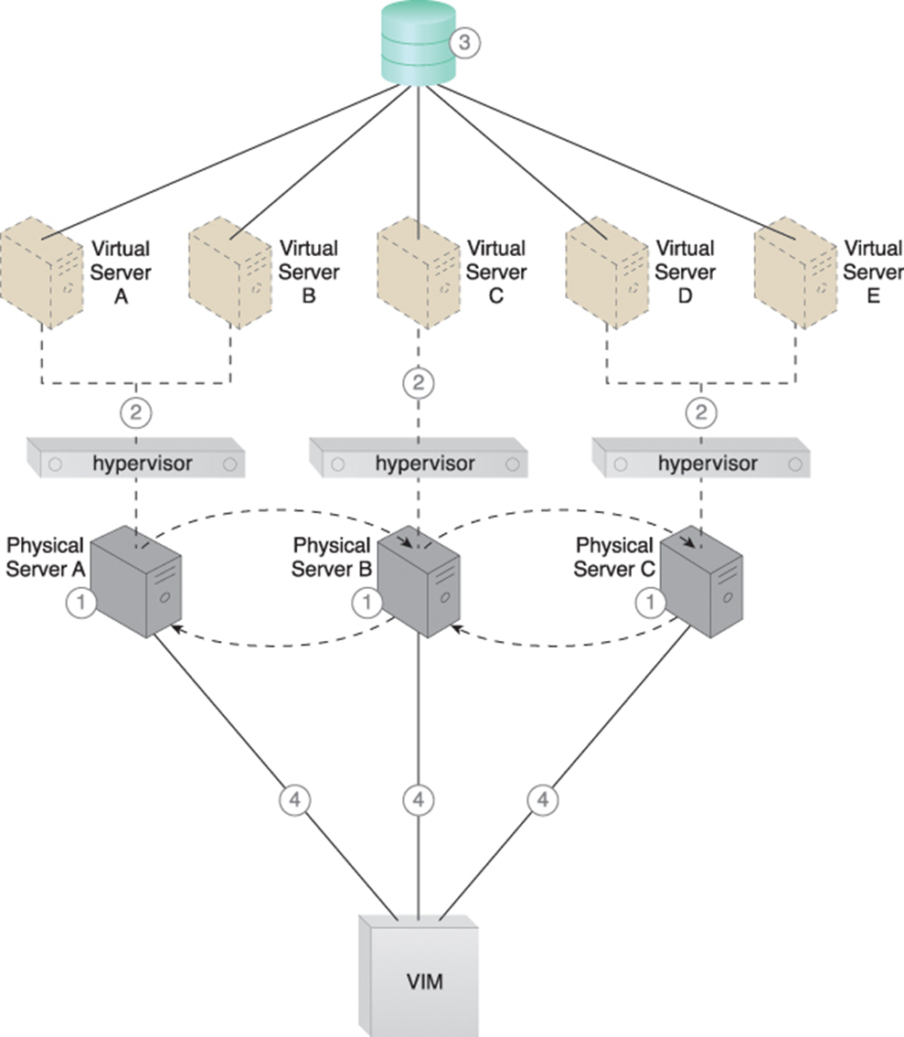

Slide 10
In previous figure,
Hypervisors are installed on Physical Servers A, B, and C (1).
Virtual servers are created by the hypervisors (2).
A shared cloud storage device containing virtual server configuration files is positioned in a shared cloud storage device for access by all hypervisors (3).
The hypervisor cluster is enabled on the three physical server hosts via a central VIM (4).

Slide 11
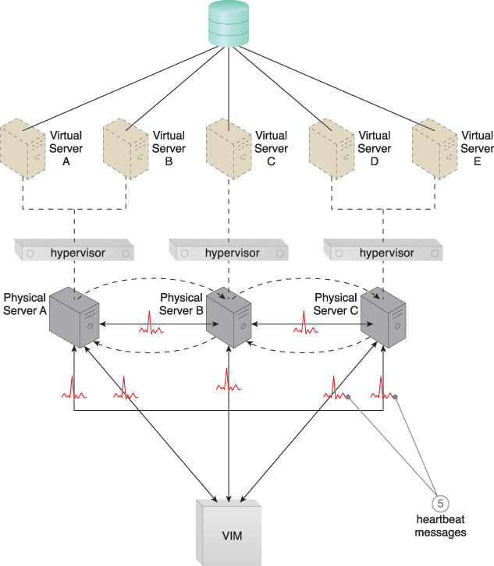
The physical servers exchange heartbeat messages with one another and the VIM according to a pre-defined schedule (5).

Slide 12
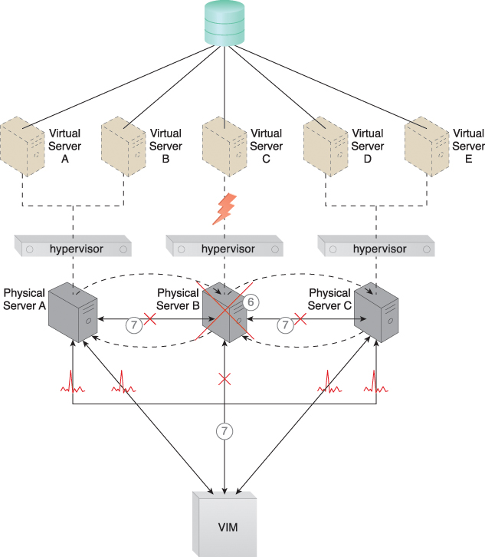
Physical Server B fails and becomes unavailable, jeopardizing Virtual Server C (6)
The other physical servers and the VIM stop receiving heartbeat messages from Physical Server B (7)

Slide 13
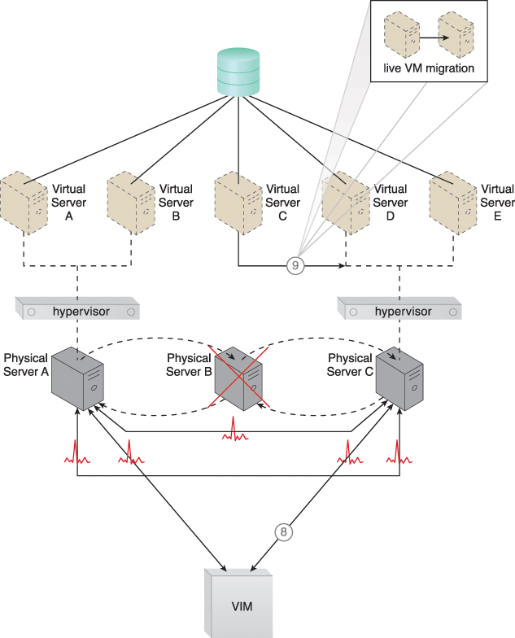
The VIM chooses Physical Server C as the new host to take ownership of Virtual Server C after assessing the available capacity of other hypervisors in the cluster (8).
Virtual Server C is live-migrated to the hypervisor running on Physical Server C, where restarting may be necessary before normal operations can be resumed (9)

Slide 14
Load Balanced Virtual Server Instances Architecture
Keeping cross-server workloads evenly balanced between physical servers whose operation and management are isolated can be challenging
A physical server can easily end up hosting more virtual servers or receive larger workloads than its neighboring physical servers
Both physical server over and under-utilization can increase dramatically over time, leading to on-going performance challenges (for over-utilized servers) and constant waste (for the lost processing potential of under-utilized servers).

Slide 15
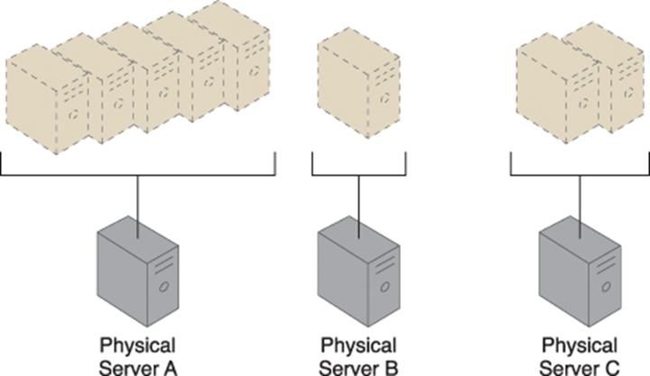
Load Balanced Virtual Server Instances Architecture
Three physical servers have to host different quantities of virtual server instances, leading to both over-utilized and under-utilized servers

Slide 16
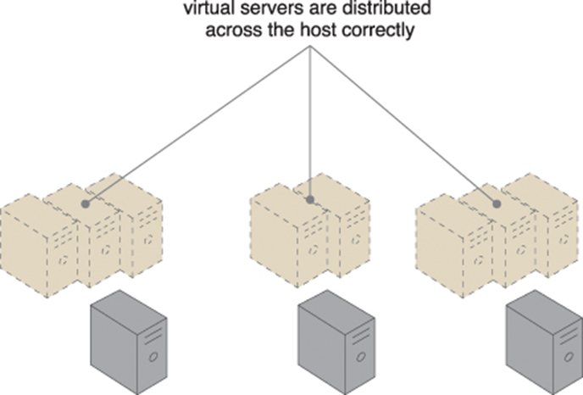
Load Balanced Virtual Server Instances Architecture
The load balanced virtual server instances architecture establishes a capacity watchdog system that dynamically calculates virtual server instances and associated workloads, before distributing the processing across available physical server hosts

Slide 17
Load Balanced Virtual Server Instances Architecture
The capacity watchdog system is comprised of a capacity watchdog cloud usage monitor, the live VM migration program, and a capacity planner.
The capacity watchdog monitor tracks physical and virtual server usage and reports any significant fluctuations to the capacity planner, which is responsible for dynamically calculating physical server computing capacities against virtual server capacity requirements.
If the capacity planner decides to move a virtual server to another host to distribute the workload, the live VM migration program is signaled to move the virtual server

Slide 18
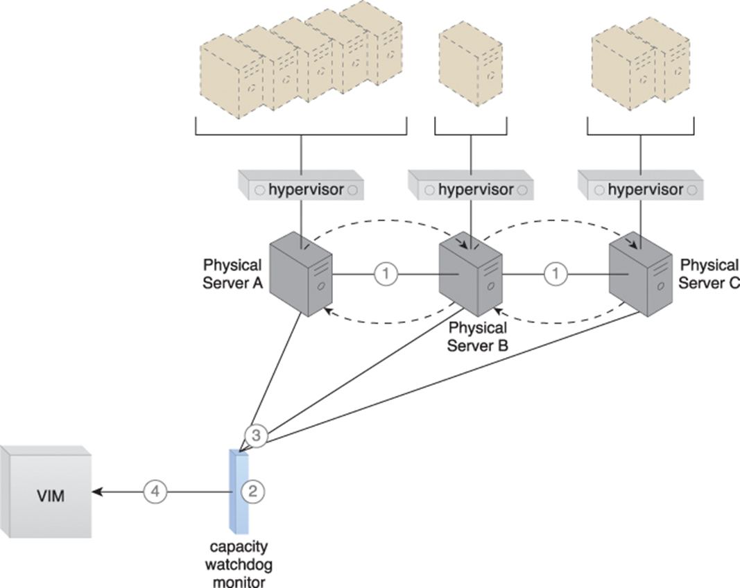
The hypervisor cluster architecture provides the foundation upon which the load-balanced virtual server architecture is built (1)
Policies and thresholds are defined for the capacity watchdog monitor (2)
which compares physical server capacities with virtual server processing (3)
The capacity watchdog monitor reports an over-utilization to the VIM (4)

Slide 19
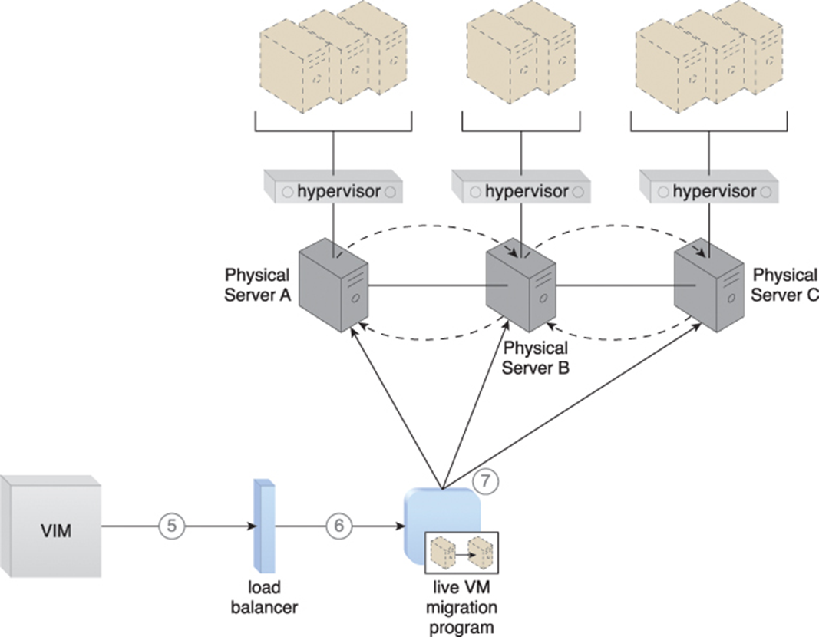
The VIM signals the load balancer to redistribute the workload based on pre-defined thresholds (5)
The load balancer initiates the live VM migration program to move the virtual servers (6)
Live VM migration moves the selected virtual servers from one physical host to another (7)

Slide 20
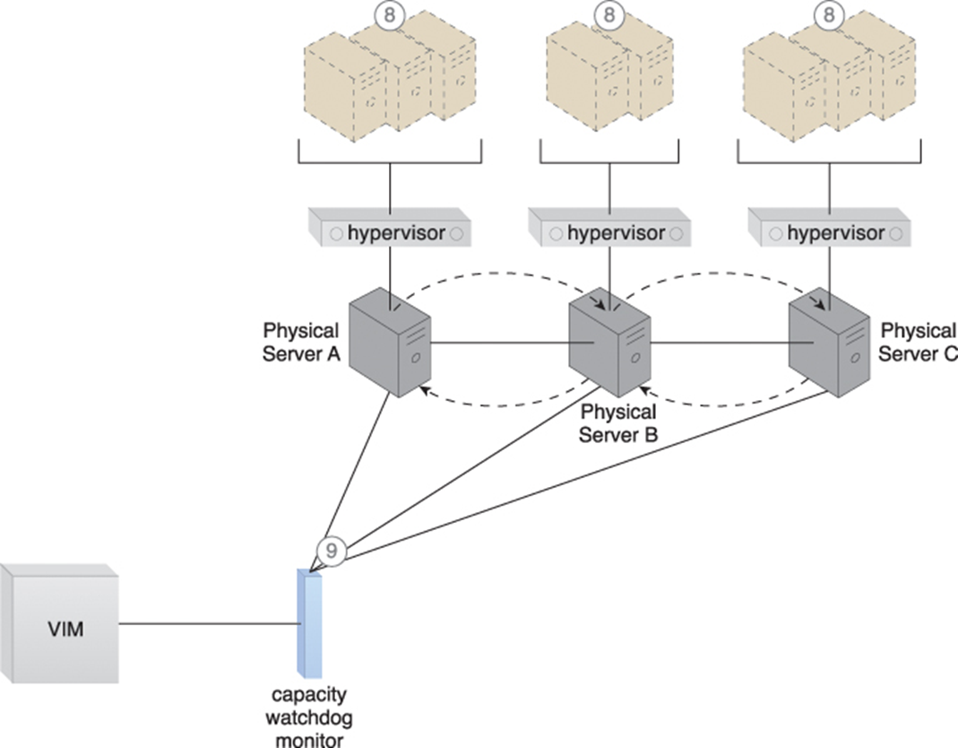
The workload is balanced across the physical servers in the cluster (8)
The capacity watchdog continues to monitor the workload and resource consumption (9)

Slide 21
Non-Disruptive Service Relocation Architecture
A cloud service can become unavailable for a number of reasons, such as:
runtime usage demands that exceed its processing capacity
a maintenance update that mandates a temporary outage
permanent migration to a new physical server host
Cloud service consumer requests are usually rejected if a cloud service becomes unavailable, which can potentially result in exception conditions
Rendering the cloud service temporarily unavailable to cloud consumers is not preferred even if the outage is planned

Slide 22
Non-Disruptive Service Relocation Architecture
The non-disruptive service relocation architecture establishes a system by which a predefined event triggers the duplication or migration of a cloud service implementation at runtime, thereby avoiding any disruption.
Instead of scaling cloud services in or out with redundant implementations, cloud service activity can be temporarily diverted to another hosting environment at runtime by adding a duplicate implementation onto a new host.
Similarly, cloud service consumer requests can be temporarily redirected to a duplicate implementation when the original implementation needs to undergo a maintenance outage
The relocation of the cloud service implementation and any cloud service activity can also be permanent to accommodate cloud service migrations to new physical server hosts

Slide 23
Non-Disruptive Service Relocation Architecture
A key aspect of the underlying architecture is that the new cloud service implementation is guaranteed to be successfully receiving and responding to cloud service consumer requests before the original cloud service implementation is deactivated or removed
A common approach is for live VM migration to move the entire virtual server instance that is hosting the cloud service
The automated scaling listener and/or load balancer mechanisms can be used to trigger a temporary redirection of cloud service consumer requests, in response to scaling and workload distribution requirements
Either mechanism can contact the VIM to initiate the live VM migration process

Slide 24
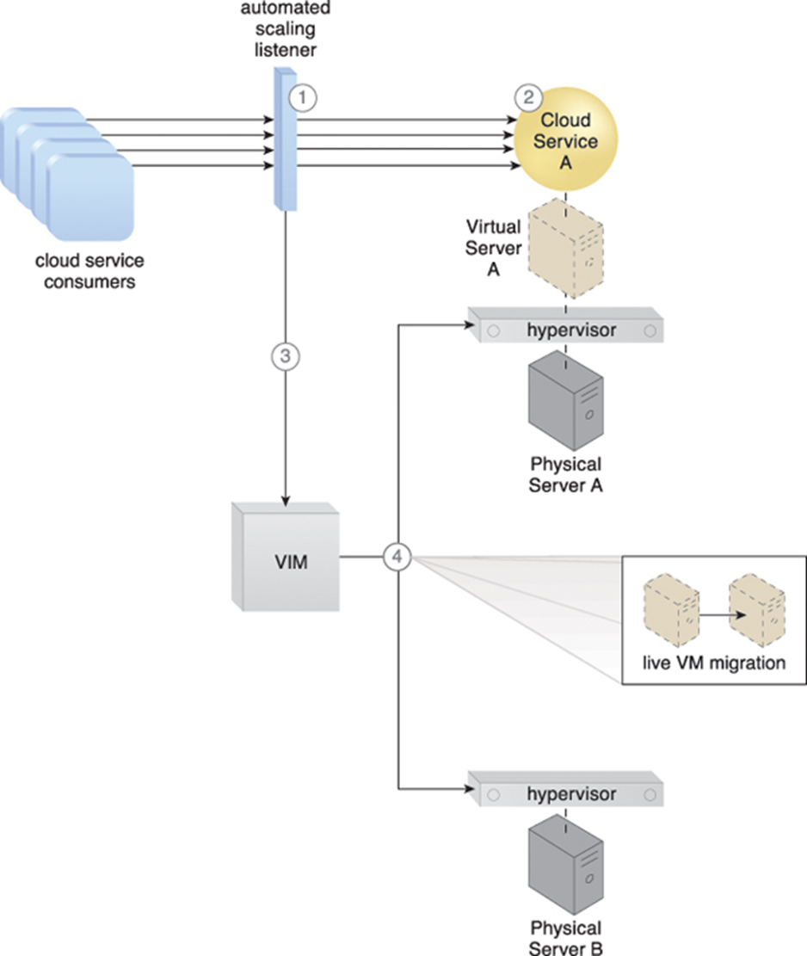
The automated scaling listener monitors the workload for a cloud service (1)
The cloud service’s predefined threshold is reached as the workload increases (2),
causing the automated scaling listener to signal the VIM to initiate relocation (3)
The VIM uses the live VM migration program to instruct both the origin and destination hypervisors to carry out runtime relocation (4)

Slide 25
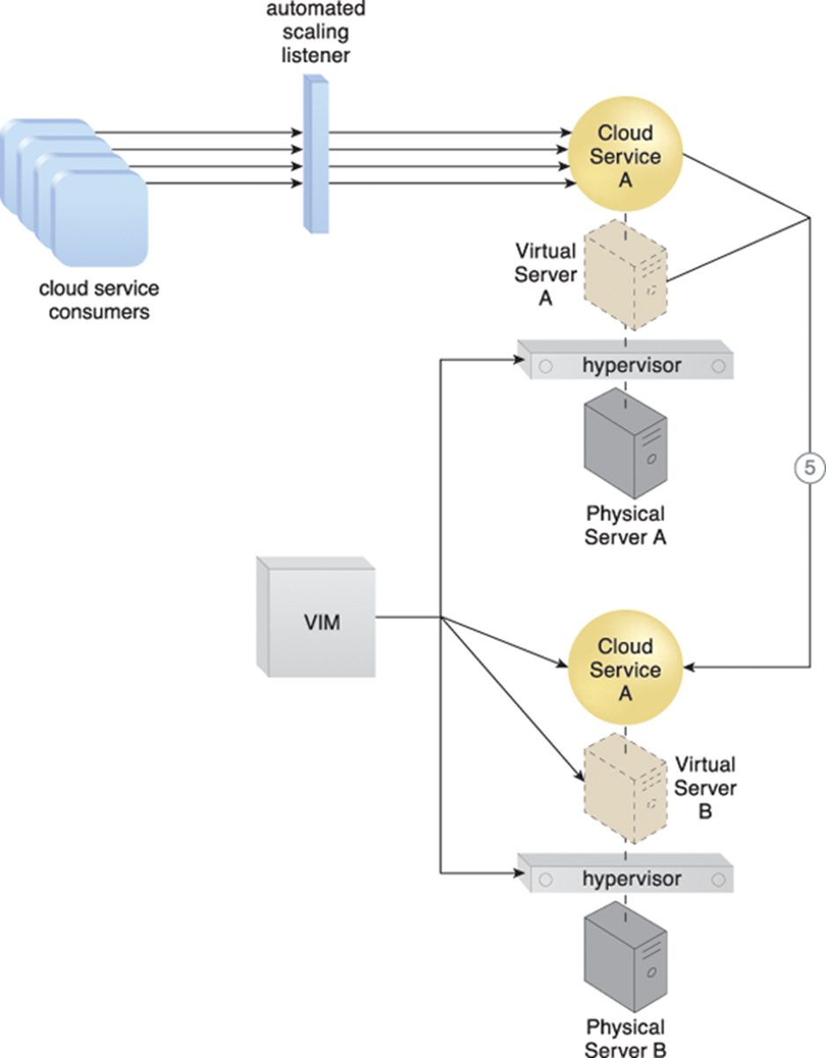
A second copy of the virtual server and its hosted cloud service are created via the destination hypervisor on Physical Server B (5)

Slide 26
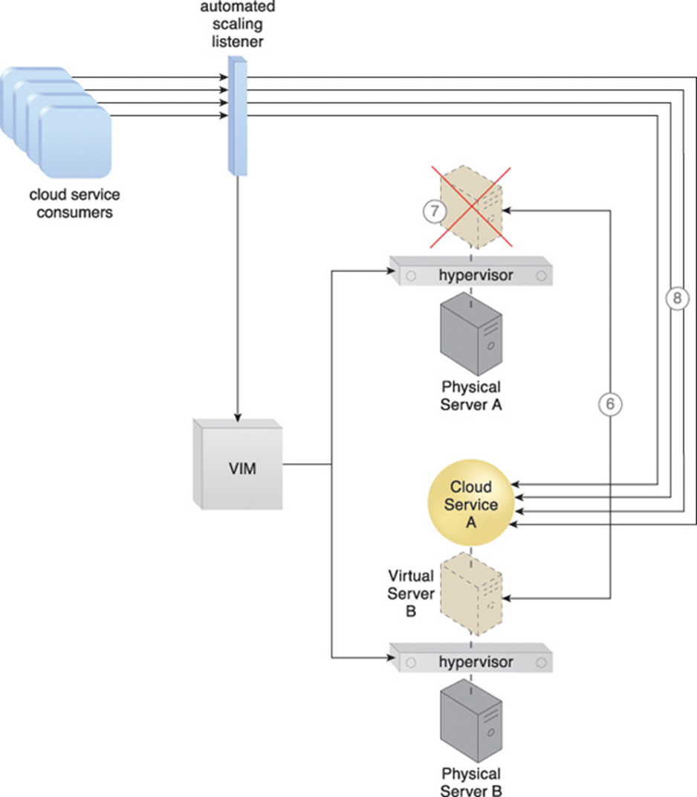
The state of both virtual server instances is synchronized (6)
The first virtual server instance is removed from Physical Server A after cloud service consumer requests are confirmed to be successfully exchanged with the cloud service on Physical Server B (7)
Cloud service consumer requests are now only sent to the cloud service on Physical Server B (8)

Slide 27
Non-Disruptive Service Relocation Architecture
Virtual server migration can occur in one of the following two ways, depending on the location of the virtual server’s disks and configuration:
A copy of the virtual server disks is created on the destination host, if the virtual server disks are stored on a local storage device or non-shared remote storage devices attached to the source host. After the copy has been created, both virtual server instances are synchronized and virtual server files are removed from the origin host.
Copying the virtual server disks is unnecessary if the virtual server’s files are stored on a remote storage device that is shared between origin and destination hosts. Ownership of the virtual server is simply transferred from the origin to the destination physical server host, and the virtual server’s state is automatically synchronized.

Slide 28
Zero Downtime Architecture
A physical server naturally acts as a single point of failure for the virtual servers it hosts
As a result, when the physical server fails or is compromised, the availability of any (or all) hosted virtual servers can be affected
This makes the issuance of zero downtime guarantees by a cloud provider to cloud consumers challenging
The zero downtime architecture establishes a sophisticated failover system that allows virtual servers to be dynamically moved to different physical server hosts, in the event that their original physical server host fails

Slide 29
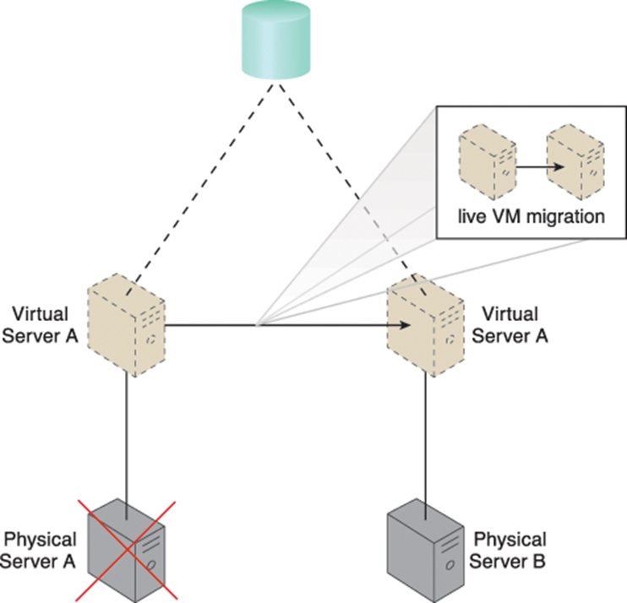
Zero Downtime Architecture
Physical Server A fails triggering the live VM migration program to dynamically move Virtual Server A to Physical Server B

Slide 30
Zero Downtime Architecture
Multiple physical servers are assembled into a group that is controlled by a fault tolerance system capable of switching activity from one physical server to another, without interruption
The live VM migration component is typically a core part of this form of high availability cloud architecture
The resulting fault tolerance assures that, in case of physical server failure, hosted virtual servers will be migrated to a secondary physical server
All virtual servers are stored on a shared volume (as per the persistent virtual network configuration architecture) so that other physical server hosts in the same group can access their files

Slide 31
Cloud Balancing Architecture
The cloud balancing architecture establishes a specialized architectural model in which IT resources can be load-balanced across multiple clouds
The cross-cloud balancing of cloud service consumer requests can help:
improve the performance and scalability of IT resources
increase the availability and reliability of IT resources
improve load-balancing and IT resource optimization

Slide 32
Cloud Balancing Architecture
Cloud balancing functionality is primarily based on the combination of the automated scaling listener and failover system mechanisms
Many more components (and possibly other mechanisms) can be part of a complete cloud balancing architecture

Slide 33
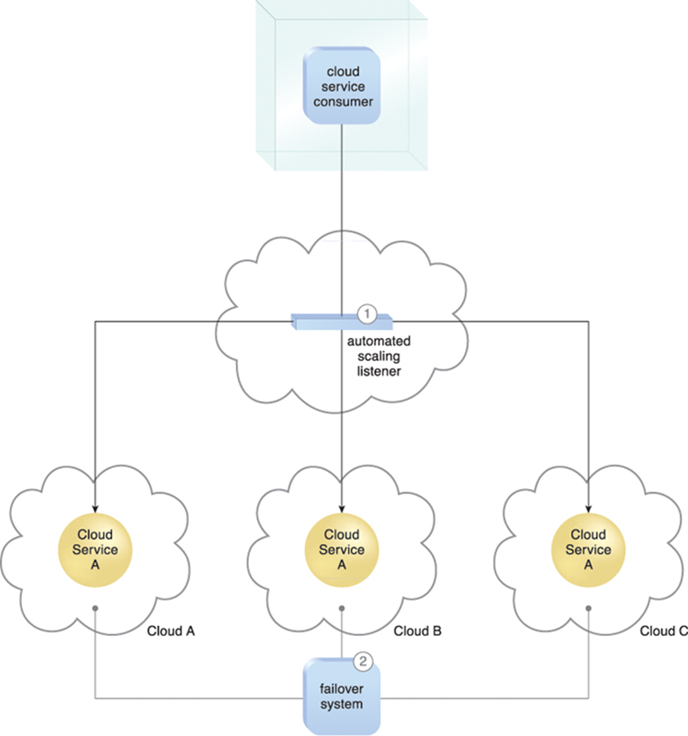
An automated scaling listener controls the cloud balancing process by routing cloud service consumer requests to redundant implementations of Cloud Service A distributed across multiple clouds (1)
The failover system instills resiliency within this architecture by providing cross-cloud failover (2)

Slide 34
Cloud Balancing Architecture
As a starting point, the two mechanisms are utilized as follows:
The automated scaling listener redirects cloud service consumer requests to one of several redundant IT resource implementations, based on current scaling and performance requirements.
The failover system ensures that redundant IT resources are capable of cross-cloud failover in the event of a failure within an IT resource or its underlying hosting environment. IT resource failures are announced so that the automated scaling listener can avoid inadvertently routing cloud service consumer requests to unavailable or unstable IT resources.

Slide 35
Resource Reservation Architecture
Depending on how IT resources are designed for shared usage and depending on their available levels of capacity, concurrent access can lead to a runtime exception condition called resource constraint
A resource constraint is a condition that occurs when two or more cloud consumers have been allocated to share an IT resource that does not have the capacity to accommodate the total processing requirements of the cloud consumers
As a result, one or more of the cloud consumers encounter degraded performance or may be rejected altogether
The cloud service itself may go down, resulting in all cloud consumers being rejected

Slide 36
Resource Reservation Architecture
Other types of runtime conflicts can occur when an IT resource (especially one not specifically designed to accommodate sharing) is concurrently accessed by different cloud service consumers
For example, nested and sibling resource pools introduce the notion of resource borrowing, whereby one pool can temporarily borrow IT resources from other pools
A runtime conflict can be triggered when the borrowed IT resource is not returned due to prolonged usage by the cloud service consumer that is borrowing it
This can inevitably lead back to the occurrence of resource constraints

Slide 37
Resource Reservation Architecture
The resource reservation architecture establishes a system whereby one of the following is set aside exclusively for a given cloud consumer
single IT resource
portion of an IT resource
multiple IT resources

Slide 38
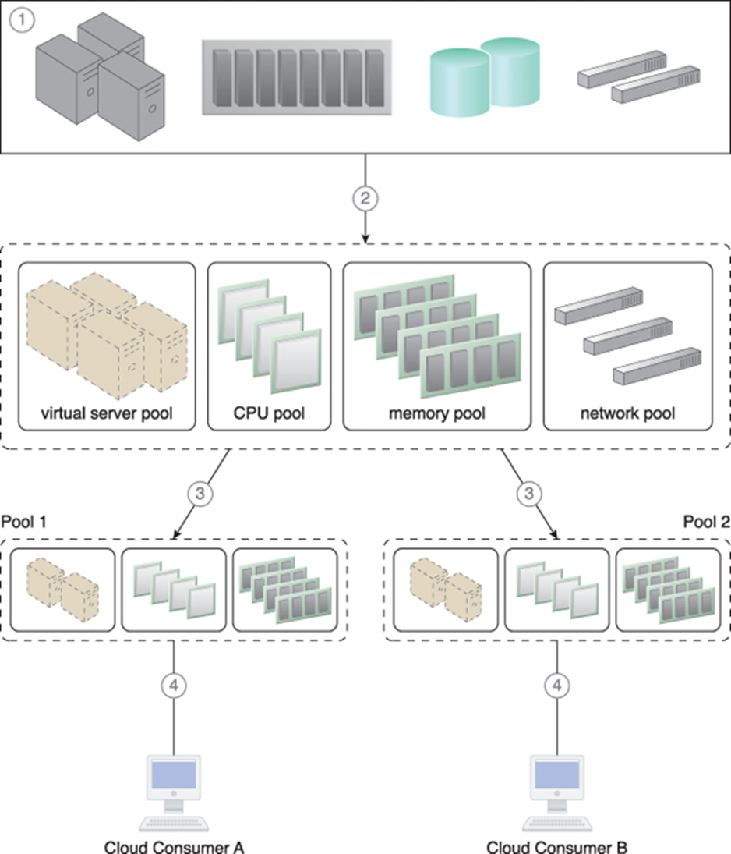
A physical resource group is created (1), from which a parent resource pool is created as per the resource pooling architecture (2)
Two smaller child pools are created from the parent resource pool, and resource limits are defined using the resource management system (3)
Cloud consumers are provided with access to their own exclusive resource pools (4)

Slide 39

An increase in requests from Cloud Consumer A results in more IT resources being allocated to that cloud consumer (5), meaning some IT resources need to be borrowed from Pool 2
The amount of borrowed IT resources is confined by the resource limit that was defined in Step 3, to ensure that Cloud Consumer B will not face any resource constraints (6)

Slide 40
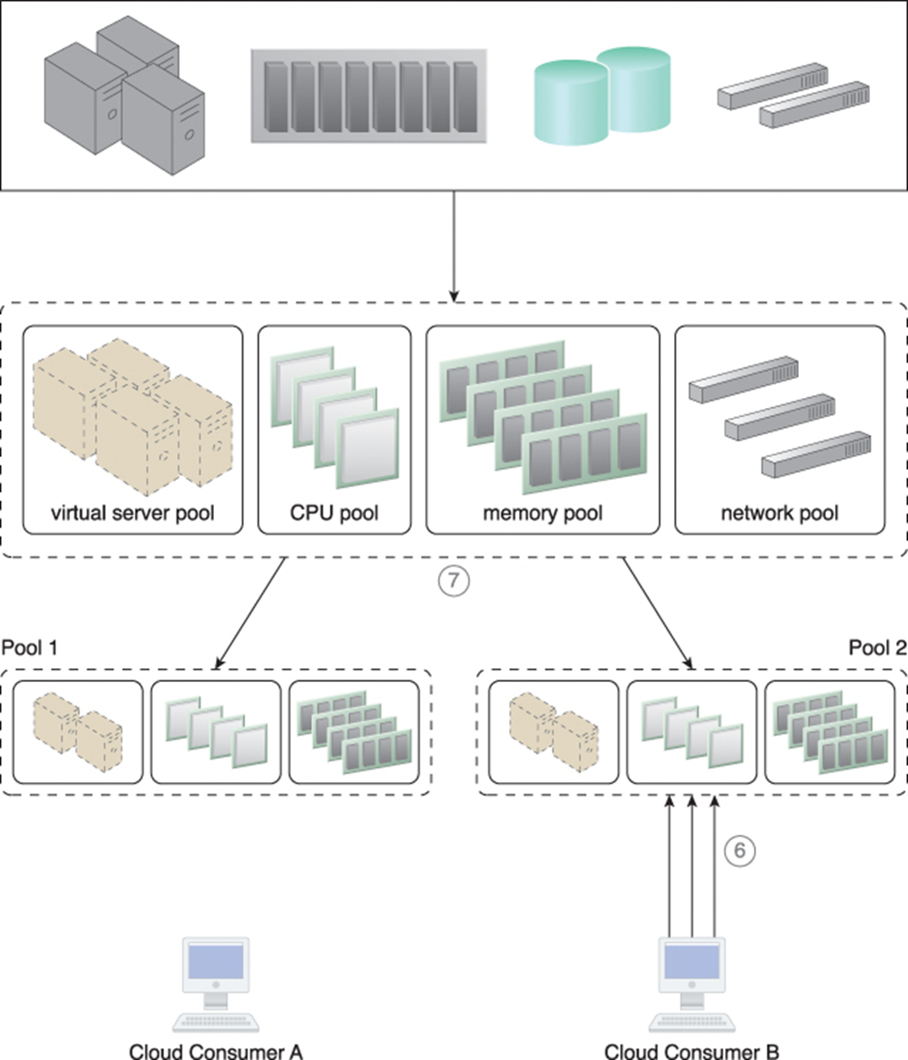
Cloud Consumer B now imposes more requests and usage demands and may soon need to utilize all available IT resources in the pool (6)
The resource management system forces Pool 1 to release the IT resources and move them back to Pool 2 to become available for Cloud Consumer B (7)

Slide 41
Resource Reservation Architecture
This protects cloud consumers from each other by avoiding the aforementioned resource constraint and resource borrowing conditions
The creation of an IT resource reservation system can require involving the resource management system mechanism, which is used to define the usage thresholds for individual IT resources and resource pools
Reservations lock the amount of IT resources that each pool needs to keep, with the balance of the pool’s IT resources still available for sharing and borrowing
The remote administration system mechanism is also used to enable front-end customization, so that cloud consumers have administration controls for the management of their reserved IT resource allocations

Slide 42
Dynamic Failure Detection and Recovery Architecture
Cloud-based environments can be comprised of vast quantities of IT resources that are simultaneously accessed by numerous cloud consumers
Any of those IT resources can experience failure conditions that require more than manual intervention to resolve
Manually administering and solving IT resource failures is generally inefficient and impractical.

Slide 43
Dynamic Failure Detection and Recovery Architecture
The dynamic failure detection and recovery architecture establishes a resilient watchdog system to monitor and respond to a wide range of pre-defined failure scenarios
This system notifies and escalates the failure conditions that it cannot automatically resolve itself
It relies on a specialized cloud usage monitor called the intelligent watchdog monitor to actively track IT resources and take pre-defined actions in response to pre-defined events.

Slide 44
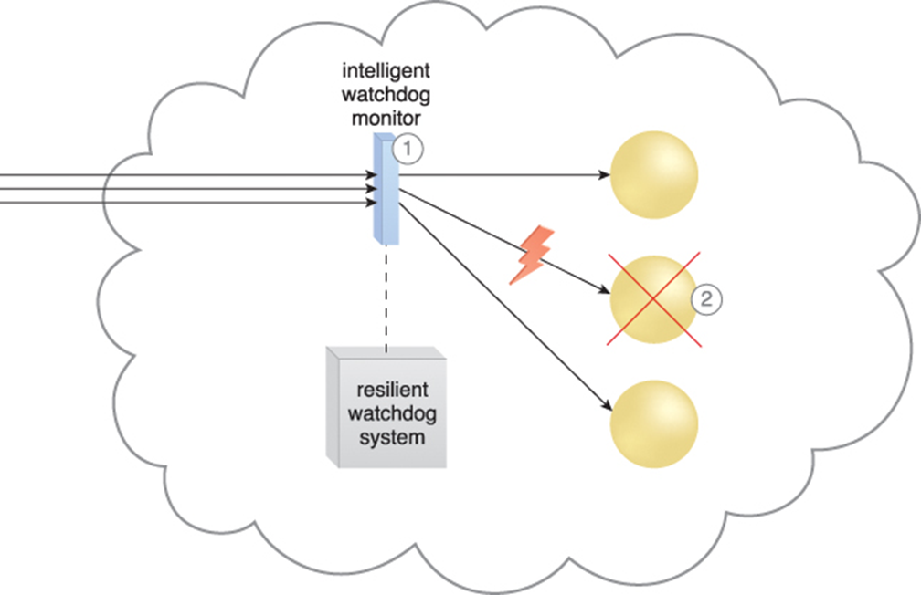
The intelligent watchdog monitor keeps track of cloud consumer requests (1) and detects that a cloud service has failed (2)

Slide 45
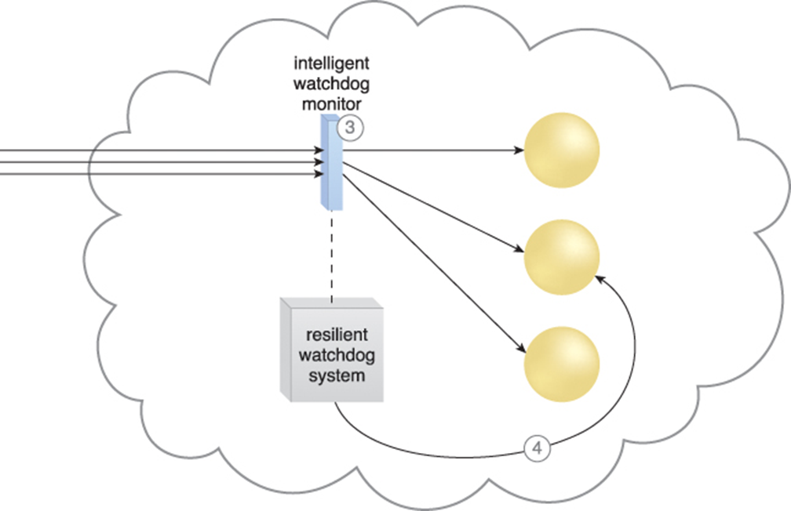
The intelligent watchdog monitor notifies the watchdog system (3), which restores the cloud service based on pre-defined policies
The cloud service resumes its runtime operation (4)

Slide 46
The resilient watchdog system performs the following five core functions:
watching
deciding upon an event
acting upon an event
reporting
Escalating
Sequential recovery policies can be defined for each IT resource to determine the steps that the intelligent watchdog monitor needs to take when a failure condition occurs
For example, a recovery policy can state that one recovery attempt needs to be automatically carried out before issuing a notification

Slide 47
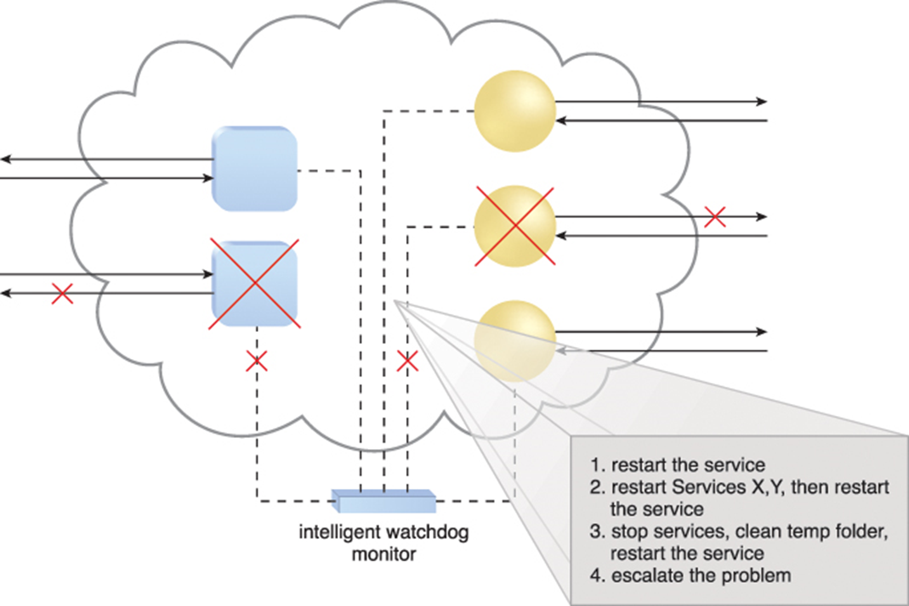
In the event of a failure, the intelligent watchdog monitor refers to its pre-defined policies to recover the cloud service step-by-step, escalating the process when a problem proves to be deeper than expected

Slide 48
Some of the actions the intelligent watchdog monitor commonly takes to escalate an issue include:
running a batch file
sending a console message
sending a text message
sending an email message
sending an SNMP trap
logging a ticket

Slide 49
Bare-Metal Provisioning Architecture
Remotely provisioning servers is common because remote management software is usually native to the operating system of most physical servers
However, access to conventional remote management programs is unavailable for bare-metal servers—physical servers that do not have pre-installed operating systems or any other software.
Most contemporary physical servers provide the option of installing remote management support in the server’s ROM
This is offered by some vendors through an expansion card while others have the components already integrated into the chipset
The bare-metal provisioning architecture establishes a system that utilizes this feature with specialized service agents, which are used to discover and effectively provision entire operating systems remotely

Slide 50
Bare-Metal Provisioning Architecture
The remote management software that is integrated with the server’s ROM becomes available upon server start-up
A Web-based or proprietary user-interface, like the portal provided by the remote administration system, is usually used to connect to the physical server’s native remote management interface
The IP address of the remote management interface can be configured manually, through the default IP, or alternatively set through the configuration of a DHCP service
IP addresses in IaaS platforms can be forwarded directly to cloud consumers so that they can perform bare-metal operating system installations independently

Slide 51
Bare-Metal Provisioning Architecture
Although remote management software is used to enable connections to physical server consoles and deploy operating systems, there are two common concerns about its usage:
Manual deployment on multiple servers can be vulnerable to inadvertent human and configuration errors.
Remote management software can be time-intensive and require significant runtime IT resource processing.

Slide 52
Bare-Metal Provisioning Architecture
The bare-metal provisioning system addresses these issues by using the following components:
Discovery Agent – A type of monitoring agent that searches and finds available physical servers to be assigned to cloud consumers.
Deployment Agent – A management agent that is installed into a physical server’s memory, to be positioned as a client for the bare-metal provisioning deployment system.
Discovery Section – A software component that scans the network and locates available physical servers with which to connect.
Management Loader – The component that connects to the physical server and loads the management options for the cloud consumer.
Deployment Component – The component responsible for installing the operating system on the selected physical servers.

Slide 53
Bare-Metal Provisioning Architecture
The bare-metal provisioning system provides an auto-deployment feature that allows cloud consumers to connect to the deployment software and provision more than one server or operating system at the same time
The central deployment system connects to the servers via their management interfaces, and uses the same protocol to upload and operate as an agent in the physical server’s RAM
The bare-metal server then becomes a raw client with a management agent installed, and the deployment software uploads the required setup files to deploy the operating system

Slide 54
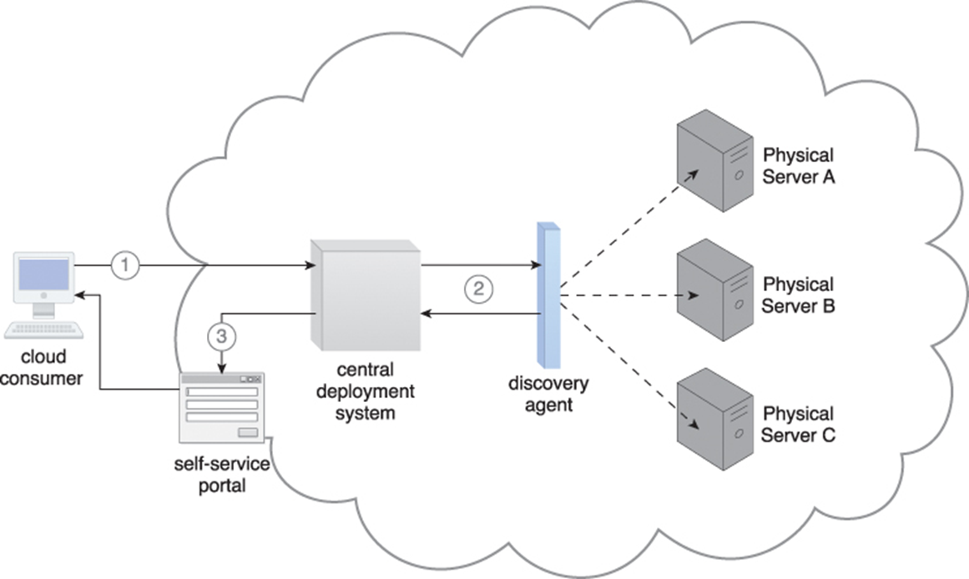
The cloud consumer connects to the deployment solution (1) to perform a search using the discovery agent (2)
The available physical servers are shown to the cloud consumer (3)

Slide 55
Deployment images, operating system deployment automation, or unattended deployment and post installation configuration scripts can be used via the intelligent automation engine and self-service portal to extend this functionality.

Slide 56
The following additional mechanisms can be part of this architecture:
Cloud Storage Device – This mechanism stores operating system templates and installation files, as well as deployment agents and deployment packages for the provisioning system.
Hypervisor – The deployment of hypervisors on physical servers as part of the operating system provisioning can be required
Logical Network Perimeter – Logical network perimeter boundaries help ensure that raw physical servers can only be accessed by authorized cloud consumers.
Resource Replication – This mechanism is implemented for the replication of IT resources by deploying a new hypervisor on a physical server to balance the hypervisor workload during or after provisioning.
SLA Management System – This management system ensures that the availability of physical bare-metal servers is in accordance with pre-defined SLA stipulations.

Slide 57
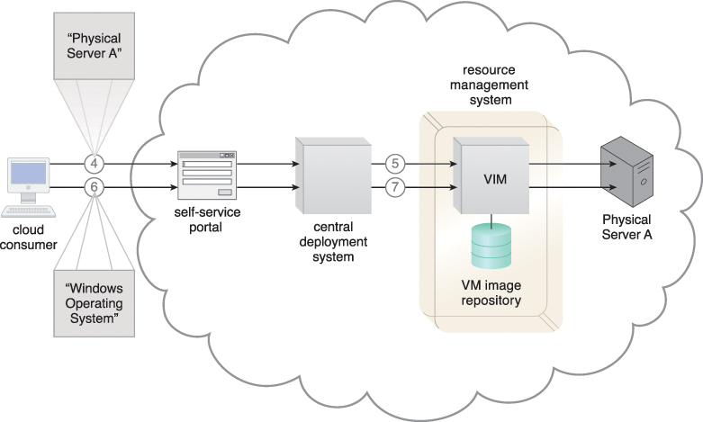
The cloud consumer selects a physical server to provision (4)
The deployment agent is loaded to the physical server’s RAM via the remote management system (5)
The cloud consumer selects an operating system and method of configuration via the deployment solution (6)
The operating system is installed and the server becomes operational (7).

Slide 58
Rapid Provisioning Architecture
A conventional provisioning process can involve a number of tasks that are traditionally completed manually by administrators and technology experts that prepare the requested IT resources as per pre-packaged specifications or custom client requests
In cloud environments, where higher volumes of customers are serviced and where the average customer requests higher volumes of IT resources, manual provisioning processes are inadequate and can even lead to unreasonable risk due to human error and inefficient response times

Slide 59
Rapid Provisioning Architecture
For example, a cloud consumer that requests the installation, configuration, and updating of twenty-five Windows servers with several applications requires that half of the applications be identical installations, while the other half be customized
Each operating system deployment can take up to 30 minutes, followed by additional time for security patches and operating system updates that require server rebooting
The applications finally need to be deployed and configured. Using a manual or semi-automated approach requires excessive amounts of time, and introduces a probability of human error that increases with each installation.

Slide 60
Rapid Provisioning Architecture
The rapid provisioning architecture establishes a system that automates the provisioning of a wide range of IT resources, either individually or as a collective
The underlying technology architecture for rapid IT resource provisioning can be sophisticated and complex, and relies on a system comprised of an automated provisioning program, rapid provisioning engine, and scripts and templates for on-demand provisioning

Slide 61
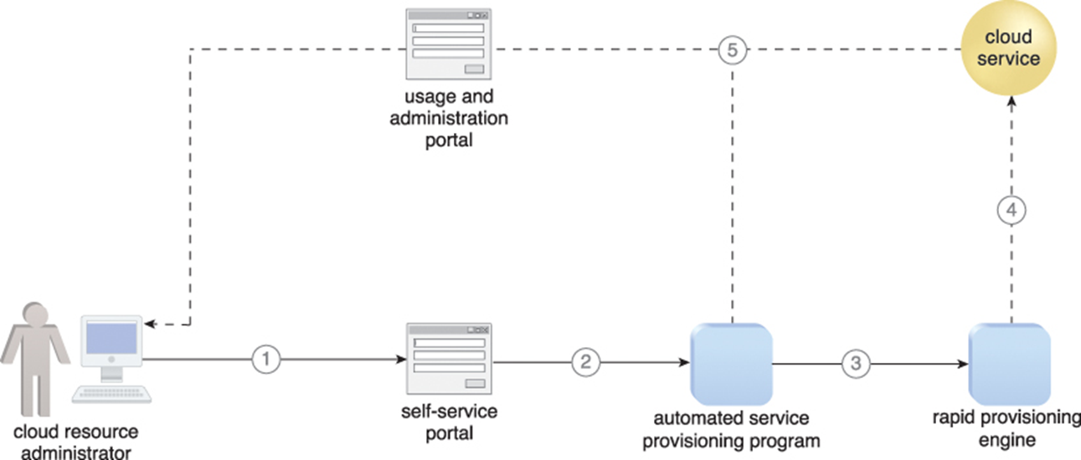
A cloud resource administrator requests a new cloud service through the self-service portal (1)
The self-service portal passes the request to the automated service provisioning program installed on the virtual server (2), which passes the necessary tasks to be performed to the rapid provisioning engine (3)
The rapid provisioning engine announces when the new cloud service is ready (4)
The automated service provisioning program finalizes and publishes the cloud service on the usage and administration portal for cloud consumer access (5)

Slide 62
Rapid Provisioning Architecture
The following step-by-step description helps provide some insight into the inner workings of a rapid provisioning engine, involving a number of the previously listed system components:
A cloud consumer requests a new server through the self-service portal.
The sequence manager forwards the request to the deployment engine for the preparation of an operating system.
The deployment engine uses the virtual server templates for provisioning if the request is for a virtual server. Otherwise, the deployment engine sends the request to provision a physical server.
The pre-defined image for the requested type of operating system is used for the provisioning of the operating system, if available. Otherwise, the regular deployment process is executed to install the operating system.

Slide 63
Rapid Provisioning Architecture
The deployment engine informs the sequence manager when the operating system is ready.
The sequence manager updates and sends the logs to the sequence logger for storage.
The sequence manager requests that the deployment engine apply the operating system baseline to the provisioned operating system.
The deployment engine applies the requested operating system baseline.
The deployment engine informs the sequence manager that the operating system baseline has been applied.
The sequence manager updates and sends the logs of completed steps to the sequence logger for storage.

Slide 64
Rapid Provisioning Architecture
The sequence manager requests that the deployment engine install the applications.
The deployment engine deploys the applications on the provisioned server.
The deployment engine informs the sequence manager that the applications have been installed.
The sequence manager updates and sends the logs of completed steps to the sequence logger for storage.
The sequence manager requests that the deployment engine apply the application’s configuration baseline.
The deployment engine applies the configuration baseline.
The deployment engine informs the sequence manager that the configuration baseline has been applied.
The sequence manager updates and sends the logs of completed steps to the sequence logger for storage.

Slide 65
Storage workload Management Architecture
Over-utilized cloud storage devices increase the workload on the storage controller and can cause a range of performance challenges
Conversely, cloud storage devices that are under-utilized are wasteful due to lost processing and storage capacity potential

Slide 66
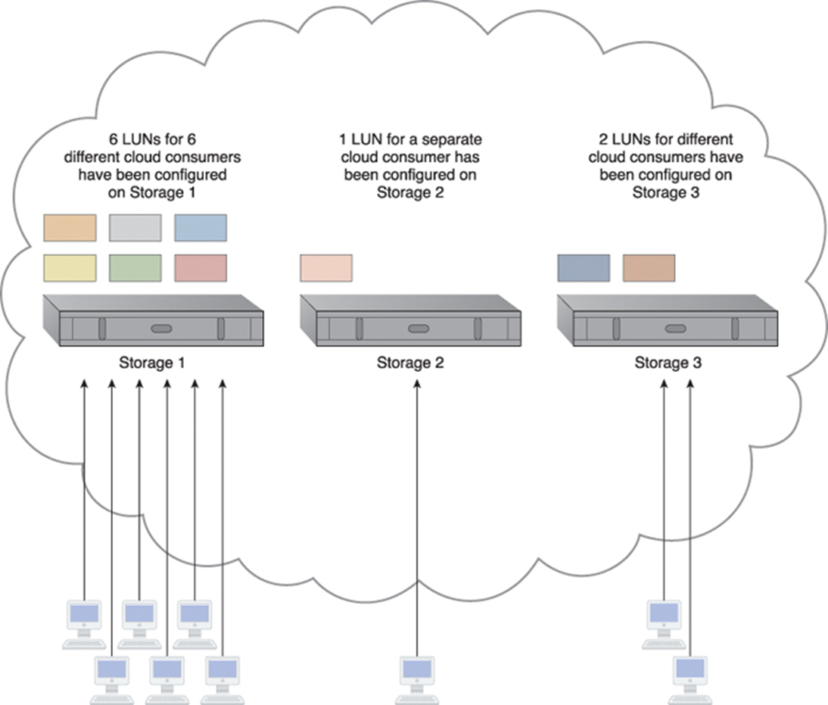
An unbalanced cloud storage architecture has six storage LUNs in Storage 1 for cloud consumers to use, while Storage 2 is hosting one LUN and Storage 3 is hosting two
The majority of the workload ends up with Storage 1, since it is hosting the most LUNs

Slide 67
Storage workload Management Architecture
The storage workload management architecture enables LUNs to be evenly distributed across available cloud storage devices, while a storage capacity system is established to ensure that runtime workloads are evenly distributed across the LUNs

Slide 68
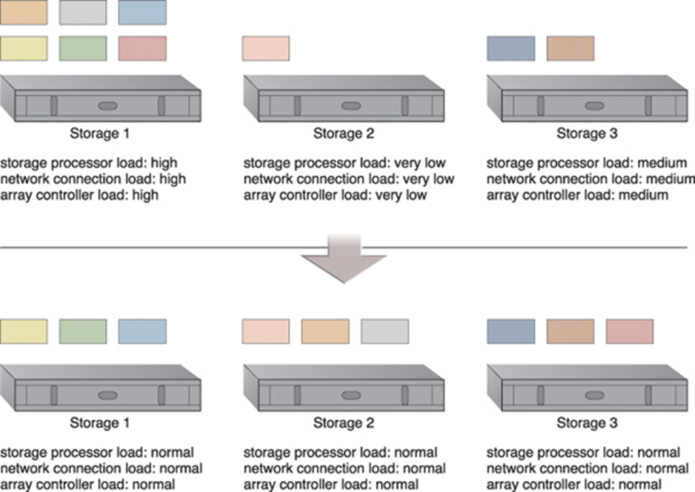
LUNs are dynamically distributed across cloud storage devices, resulting in more even distribution of associated types of workloads

Slide 69
Storage workload Management Architecture
Combining cloud storage devices into a group allows LUN data to be distributed between available storage hosts equally
A storage management system is configured and an automated scaling listener is positioned to monitor and equalize runtime workloads among the grouped cloud storage devices

Slide 70
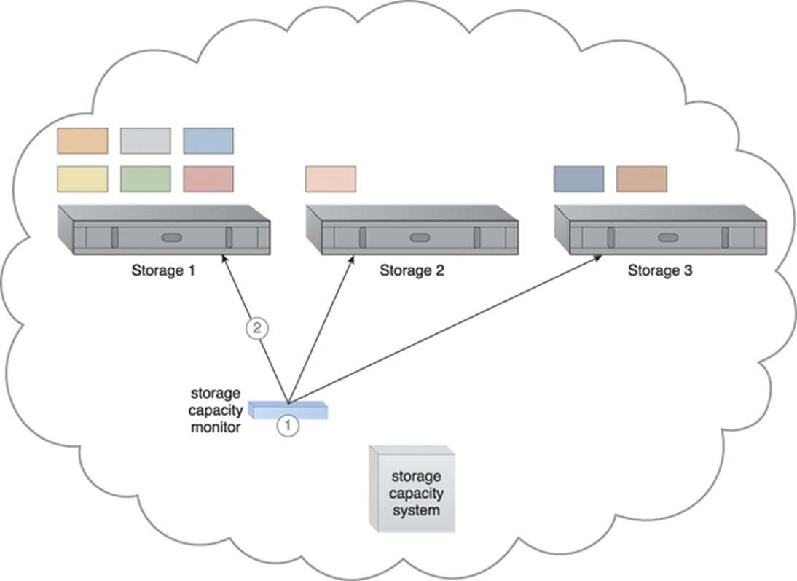
The storage capacity system and storage capacity monitor are configured to survey three storage devices in realtime, whose workload and capacity thresholds are pre-defined (1)
The storage capacity monitor determines that the workload on Storage 1 is reaching its threshold (2)

Slide 71
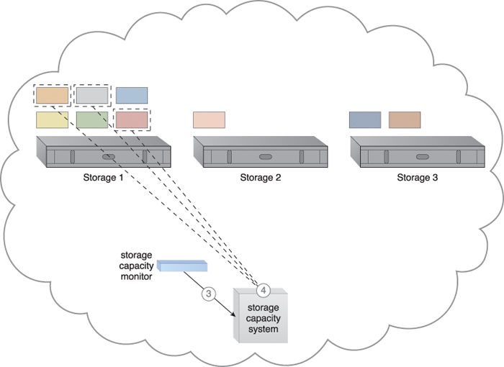
The storage capacity monitor informs the storage capacity system that Storage 1 is over-utilized (3)
The storage capacity system identifies the LUNs to be moved from Storage 1 (4)

Slide 72
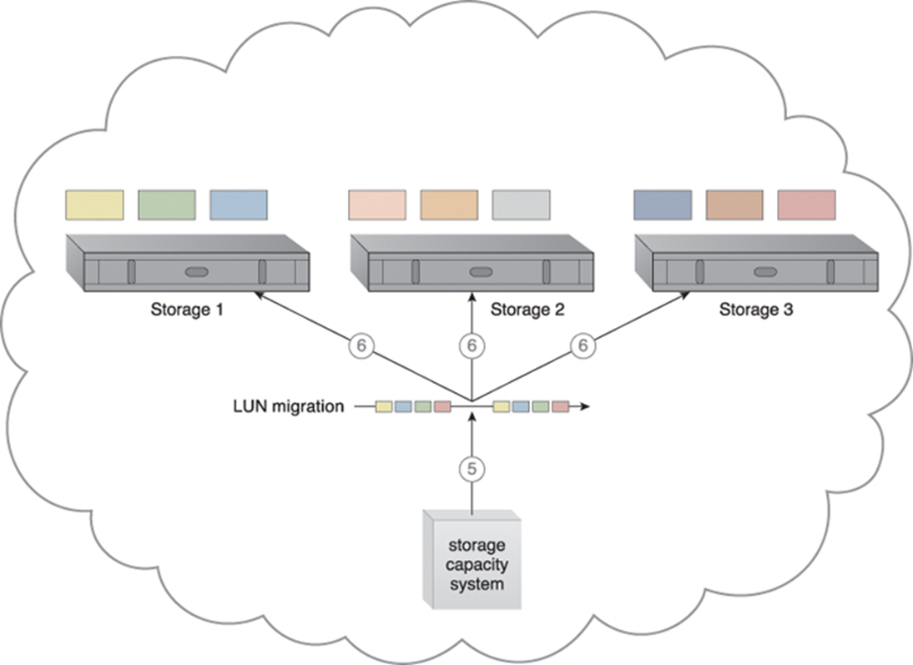
The storage capacity system calls for LUN migration to move some of the LUNs from Storage 1 to the other two storage devices (5)
LUN migration transitions LUNs to Storage 2 and 3 to balance the workload (6)

Slide 73
Storage workload Management Architecture
The storage capacity system can keep the hosting storage device in power-saving mode for the periods when the LUNs are being accessed less frequently or only at specific times

Slide 74
Thank You

